Slide 1
AI Risk Management

Slide 2
Introduction to AI Risk Management
Importance of AI Risk Management: Essential to ensure safe and compliant deployment, fostering trust in AI.
Common Challenges: Limited understanding of AI risks, leading to potential financial and legal impacts.
Focus Areas: Identifying, assessing, and mitigating AI risks; creating a framework for robust governance.
Chapter Topics: AI risk scenarios, regulatory landscape, lifecycle risk management, and ML platform design for risk governance.

Slide 3
Key AI Risk Scenarios
Bias and Discrimination: Models can learn and perpetuate biases, potentially leading to discriminatory outcomes.
Misinformation Risks: AI may propagate inaccuracies due to data errors or model limitations, impacting decision-making.
Interpretability Issues: Complex models (e.g., neural networks) are often "black boxes," making problem diagnosis difficult.
Unintended Consequences: Algorithms optimized for specific goals may ignore ethical implications, causing adverse outcomes.

Slide 4
Specific AI Risk Scenarios – Examples
Adversarial Attacks: Manipulated inputs deceive AI models, as seen in attacks on image recognition systems.
Privacy Violations: Sensitive data used in model training risks exposure if not properly managed.
Third-Party Model Risks: Use of pre-trained models can introduce inherited biases or vulnerabilities.
Insufficient Model Testing: Limited AI-specific testing tools lead to risks from inadequate validation and error analysis.

Slide 5
Regulatory Landscape for AI Risk
US Regulatory Framework: Includes guidelines like SR 11-7, which addresses model governance and validation.
EU AI Act: Risk-based approach to AI regulation with high oversight for critical AI applications (e.g., infrastructure).
International Initiatives: Emerging frameworks from different jurisdictions aim to ensure transparency and accountability.
Anticipated Trends: Expect rapid legislative developments as AI adoption grows across industries.

Slide 6
Understanding AI Risk Management
Objective: Establish trust in AI systems and ensure regulatory compliance.
Key Dimensions: Validity, ethical considerations, cybersecurity, and transparency.
Trade-offs: Balancing accuracy, privacy, and interpretability to align with organizational objectives.
Framework Components: Model Risk Management (MRM), enterprise risk management, and third-party risk management.

Slide 7
Governance Oversight Principles
Transparency: Ensure stakeholders understand AI decisions and data usage.
Accountability: Organizations must be accountable for AI outcomes and impacts.
Data Governance: Ensures ethical, accurate, and unbiased data for training AI models.
Human Oversight: Human intervention when AI systems affect critical decision-making.

Slide 8
Additional Oversight Principles
Privacy and Security: Safeguard data privacy and secure systems to mitigate financial and reputational damage.
Fairness: Prevents discrimination based on race, gender, etc., through regular fairness checks.
Validity and Reliability: Models should undergo thorough validation and reliability testing.
Compliance Requirements: Adhere to evolving regulations, especially in sensitive sectors.

Slide 9
AI Risk Management Framework – Three Lines of Defense
First Line: Business operations develop, test, and register models, tracking performance metrics.
Second Line: Risk management independently validates model documentation and results.
Third Line: Internal audit verifies process adherence and assesses risk controls across the organization.
Extended Coverage: Encompasses scalability, cybersecurity, and third-party risks beyond MRM.

Slide 10
Risk Management Across the AI Lifecycle
Business Problem Identification: Verify alignment with regulatory and ethical standards at the start.
Data Acquisition and Management: Ensure data quality, compliance, and bias mitigation in training datasets.
Experimentation and Model Development: Address model limitations, transparency, and sensitivity during testing.
Deployment and Operations: Ensure performance monitoring, fallback mechanisms, and adversarial defense.

Slide 11
Risk Identification and Assessment – Initial Phase
Risk Rating: Assess potential impacts, rating risks based on likelihood and severity.
Ethical Considerations: Weigh organizational values to avoid reputational harm.
Security and Privacy Requirements: Protect user data from unauthorized access and ensure compliance.
Mitigation Planning: Develop strategies to address high-priority risks before project initiation.

Slide 12
Data Acquisition and Management Risks
Data Selection Risks: Poor dataset representation introduces bias and misclassification risks.
Data Quality: Inaccurate data or missing values can lead to ineffective or biased models.
Data Privacy and Compliance: Ensure regulatory checks (e.g., GDPR) are enforced to protect sensitive data.
Adversarial Data Risks: Prevent data manipulation that can alter model training outcomes.

Slide 13
Mitigation Strategies for Data Risks
Data Validation Standards: Implement rigorous checks for data accuracy and completeness.
Sampling and Representation: Ensure datasets represent all target groups adequately to prevent bias.
Regulatory Compliance Checks: Incorporate compliance checks directly into the MRM process.
Data Privacy Controls: Use data masking, encryption, and access limitations to protect sensitive information.

Slide 14
Experimentation and Model Development Risks
Model Assumptions and Limitations: Validate assumptions to ensure model applicability.
Overfitting and Transparency Risks: Guard against overfitting and prioritize explainable models where necessary.
Model Fairness: Regularly assess models for biases introduced by algorithmic assumptions.
Evaluation Risks: Use appropriate validation techniques to ensure robust model performance.

Slide 15
Mitigating Model Development Risks
Comprehensive Testing: Implement sensitivity and scenario testing for robust model evaluation.
Transparency Standards: Ensure clear documentation for model assumptions and parameters.
Fairness Checks: Incorporate fairness testing at multiple stages in model development.
Model Performance Validation: Establish benchmarks and regular assessments for sustained accuracy.

Slide 16
Deployment and Operations Risks
Human Supervision: Ensure AI models undergo human review before production.
Technology Integration Challenges: Verify compatibility with existing systems to avoid integration errors.
Scalability and Performance Risks: Prepare models for varying loads and user demands.
Fallback and Attack Protections: Establish fallback mechanisms and defend against adversarial threats.

Slide 17
Mitigation for Deployment Risks
Model Registry and Documentation: Track model details, metrics, and updates systematically.
Integration Testing: Validate all connections with upstream and downstream systems for smooth operation.
Monitoring and Alerts: Continuously track model performance and activate fallback systems when needed.
Adversarial Defense Standards: Implement monitoring and defense against malicious input and data manipulation.

Slide 18
Designing ML Platforms with Governance in Mind
Platform Role in Governance: Provides tools for documentation, lineage tracking, and compliance checks.
Core Governance Touchpoints: Data stores, workflow systems, model inventory databases.
ML Platform Components: Incorporate compliance and security features into platform design.
•

Slide 19
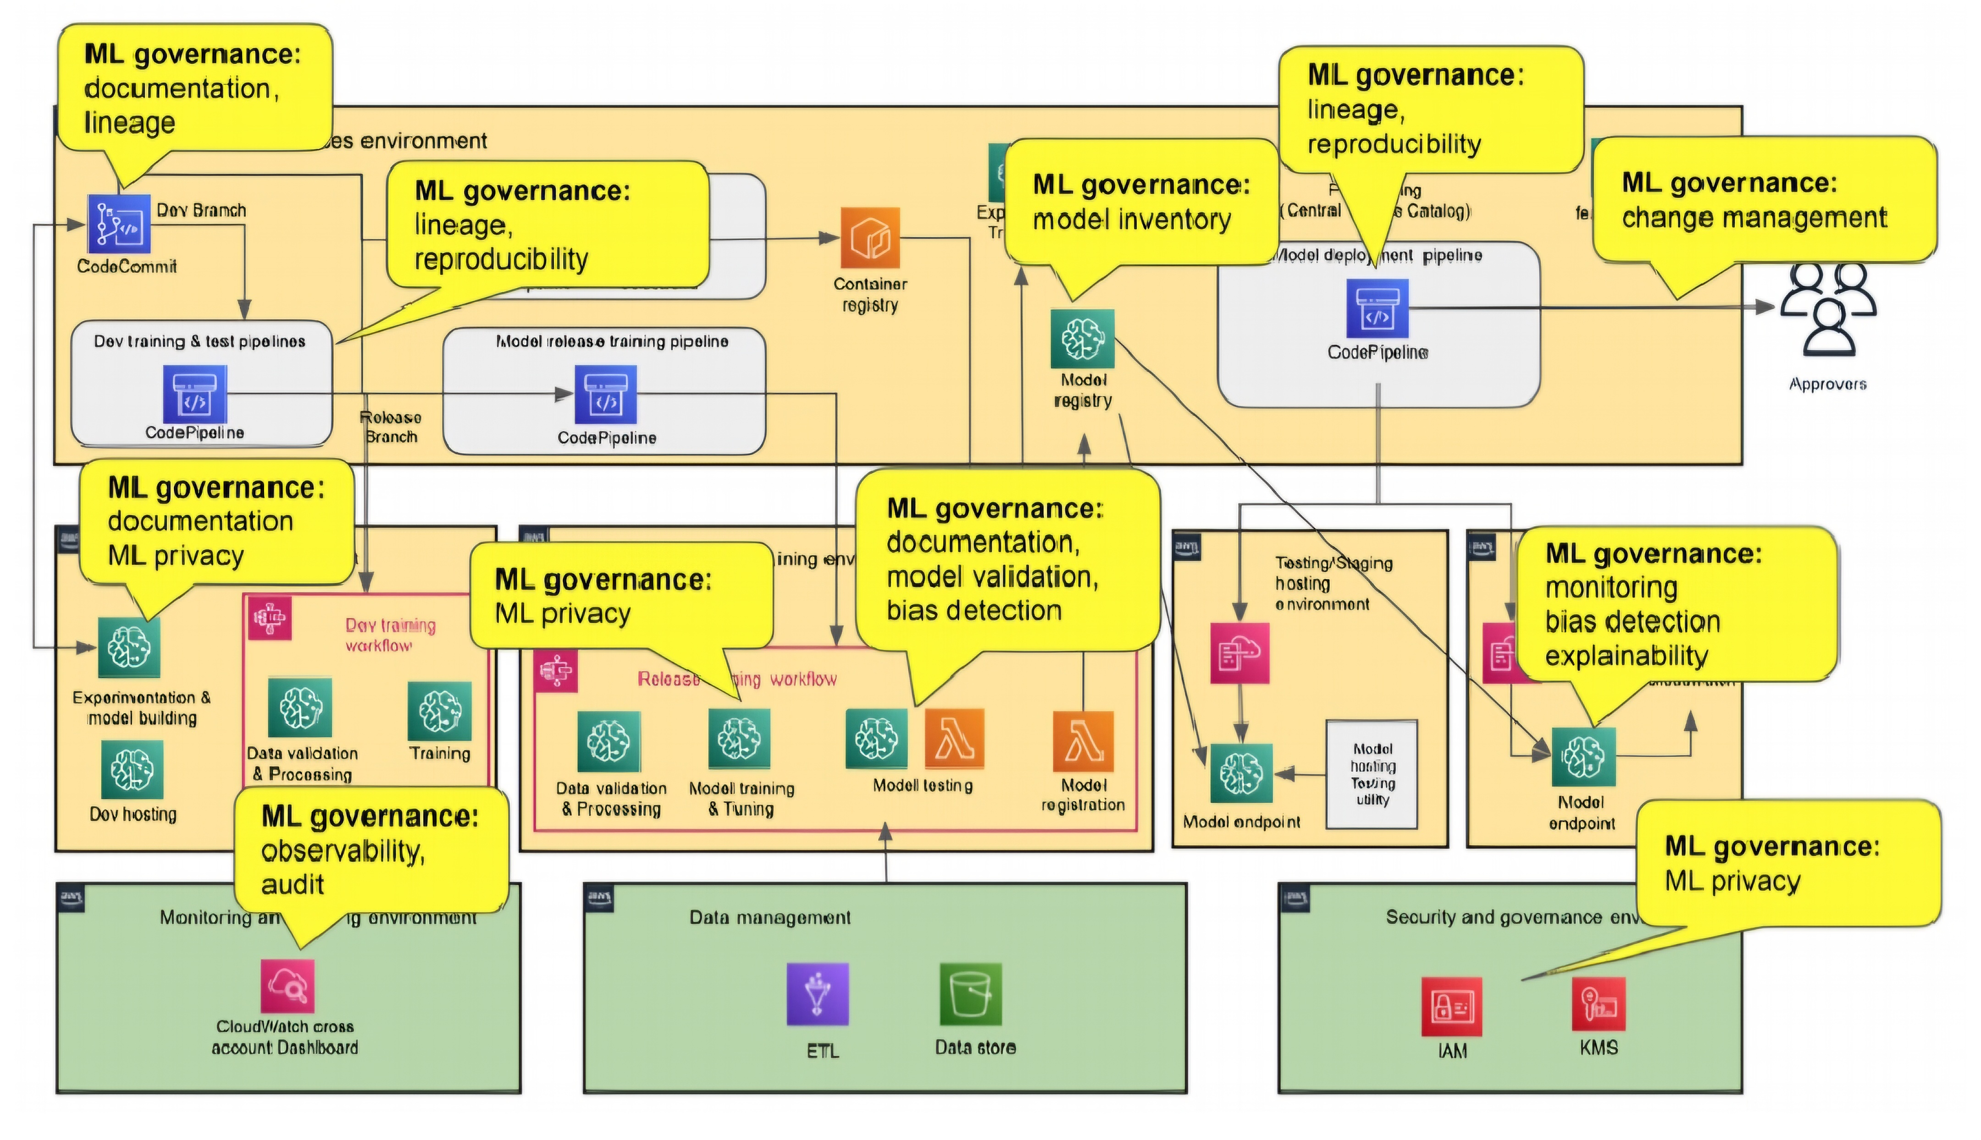
ML platform and ML governance

Slide 20
Data and Model Documentation in Governance
Data Quality Reporting: Document data sources, quality checks, and handling procedures.
Model Development and Validation: Include methodology, assumptions, and validation results.
Performance Monitoring Reports: Regularly document and monitor data drift and model behavior.
Model Usage and Compliance Tracking: Include risk rating, classification, and lifecycle details.

Slide 21
Ensuring Lineage and Reproducibility
Importance of Lineage: Track data and model origins for transparency and accountability.
SageMaker Lineage Features: Store training data sources, configurations, and artifacts for auditability.
Version Control and Metadata: Maintain control over model versions and metadata for tracking.
Audit Support: Provide lineage and reproducibility data to verify processes and meet compliance.

Slide 22
Observability and Auditing for Compliance
Audit Trails: Track user actions and system changes for transparency and accountability.
Deployment Approval Tracking: SageMaker Model Registry tracks model approvals.
Change Tracking: CloudTrail records system configuration changes for audit verification.
Automated Alerts and Monitoring: Ensure consistent tracking and alerting of system changes.

Slide 23
Scalability and Performance in ML Platforms
Training Infrastructure Scaling: Supports large-scale training with distributed nodes.
Hosting Infrastructure Scaling: Multi-Model Endpoint (MME) and auto-scaling for efficiency.
Serverless Inference: Supports scalable deployment with minimal infrastructure overhead.
Data Quality Checks: Ensure accurate and consistent data inputs across all lifecycle stages.

Slide 24
Summary and Key Takeaways
Core Principles of AI Risk Management: Transparency, accountability, privacy, and fairness.
Comprehensive Lifecycle Risk Coverage: Identifying and mitigating risks across all AI lifecycle stages.
Platform Governance: Leverage ML platforms (e.g., SageMaker) to support AI governance and compliance.
Continuous Evolution: Risk management strategies should adapt to emerging technologies and risks.

